Slide 1
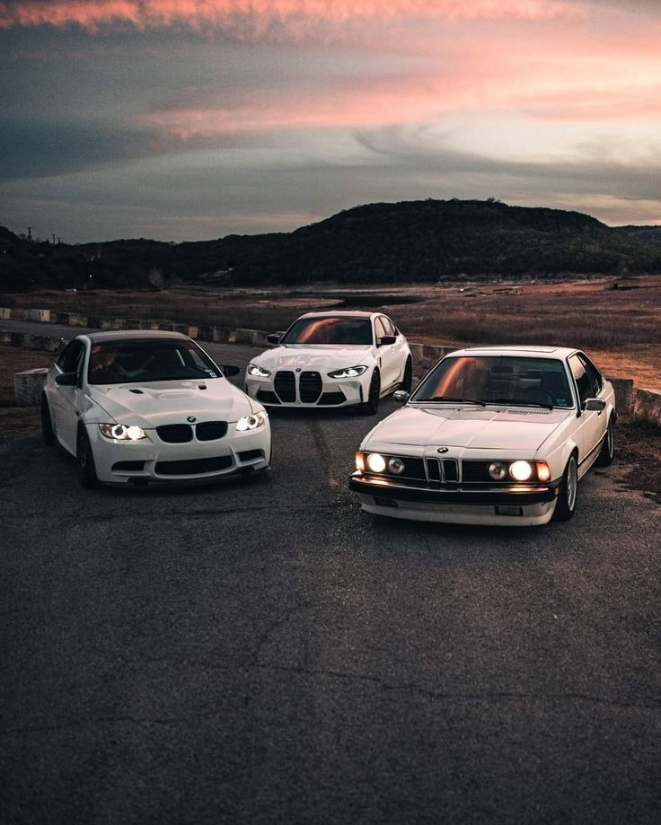
PABLO CAR COMPANY

Slide 2
INDEX
1 | introduction | 02
2 | content | 03
3 | conclusion | 05
4 | Contact us | 06

Slide 3
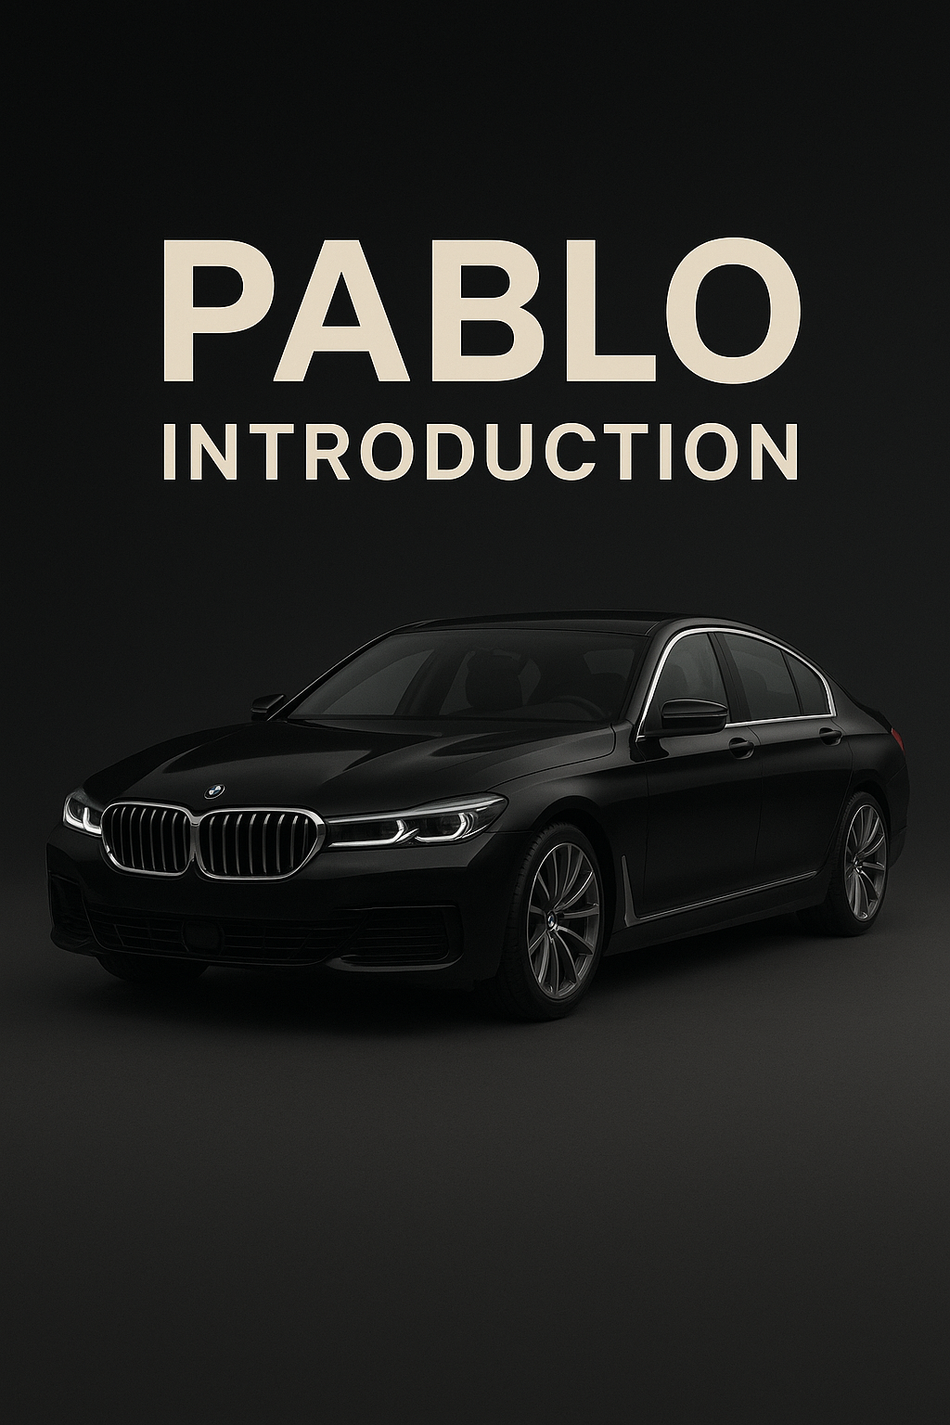
INTRODUCTION -
PABLO is a premium automotive brand built on passion, precision, and the belief that a car should be far more than a mode of transportation — it should be an extension of identity, character, and ambition. Established with the vision to redefine what true luxury means in the modern automotive world, PABLO stands proudly at the intersection of world-class craftsmanship, advanced innovation, and high-performance engineering. Every vehicle we curate reflects our unwavering commitment to authenticity, excellence, and a seamless ownership experience that our customers can trust.
PABLO Car Company was founded with a clear mission: to introduce a new era of luxury, trust, and craftsmanship to the automotive market. In today’s evolving world, a car represents more than mobility — it symbolizes personality, taste, and lifestyle. At PABLO, we embrace this understanding. Our brand is built on the pillars of precision, passion, and an uncompromising dedication to delivering only the highest standards of quality.

Slide 4

CONTENT
PABLO – A COMPANY ABOVE THE REST
Luxury reimagined. Excellence redefined. Trust perfected.
PABLO is more than a pre-owned luxury car company — it is a revolution. We don’t just sell cars; we create experiences built on trust, quality, and perfection. To us, a car is not just a machine but a reflection of identity and lifestyle. That is why PABLO consistently rises above traditional dealers and premium brands.
Where others chase numbers, PABLO chases perfection. Every car, every customer, every process reflects our mission: Deliver more. Promise less. Overperform always.
Unmatched Quality Standards
PABLO sets a higher benchmark with strict inspections, advanced diagnostics, engineering checks, and flawless detailing. Our collection includes only the finest luxury brands — BMW, Mercedes-Benz, Audi, Porsche, Jaguar, Land Rover, and more — carefully curated, never chosen for volume.
Every PABLO car feels premium, powerful, and perfected — often surpassing the typical showroom experience.
The PABLO Experience
At PABLO, you immediately feel the difference: no pressure, no rushed sales, no confusion — only expert guidance and full transparency.
Every customer receives:
Clear history reports
Verified mileage
Transparent documentation
Honest pricing
Lifetime support
Premium hospitality
We don’t just sell cars. We help you find the perfect one.
A Vision Beyond the Competition
PABLO was built to redefine luxury, trust, and service. We don’t follow trends — we create new standards. We don’t imitate global luxury brands — we exceed their purchasing experience with more choice, more value, and more authenticity.
Every PABLO car is a promise. Every customer is a priority. Every experience is unforgettable.
PABLO – LUXURY BEYOND LIMITS
When you choose PABLO, you aren’t choosing just a car — you’re choosing the company that sets the new standard.

Slide 5
CONCLUSION
PABLO stands today as far more than a luxury car company — it stands as a symbol of trust, sophistication, and unwavering excellence. In a world where automotive brands compete for attention, PABLO does not chase competition; it rises above it. Our dedication to perfection, transparency, and customer-first values has positioned us as a brand that consistently surpasses traditional dealers and even global luxury experiences.
Luxury for us is not defined by a price tag — it is defined by authenticity, personalization, and the emotional connection between the customer and the car they choose. This belief has shaped everything we do. Every vehicle we offer undergoes unmatched levels of care, inspection, and refinement. Every service we deliver is powered by passion and precision. Every customer we serve becomes part of the growing PABLO family — a community built on loyalty, integrity, and shared ambition.

Slide 6
CONTACT US
YOU CAN CONTACT US MORE IF YOU APPROACH US / WE CAN HELP YOU
OUR EMAIL ID :

